Slide 1
JNCIS-ENT
Layer 2 switching and VLANs

Slide 2
Bridging Mechanisms
2
Fundamentals of Bridging / Switching

Slide 3
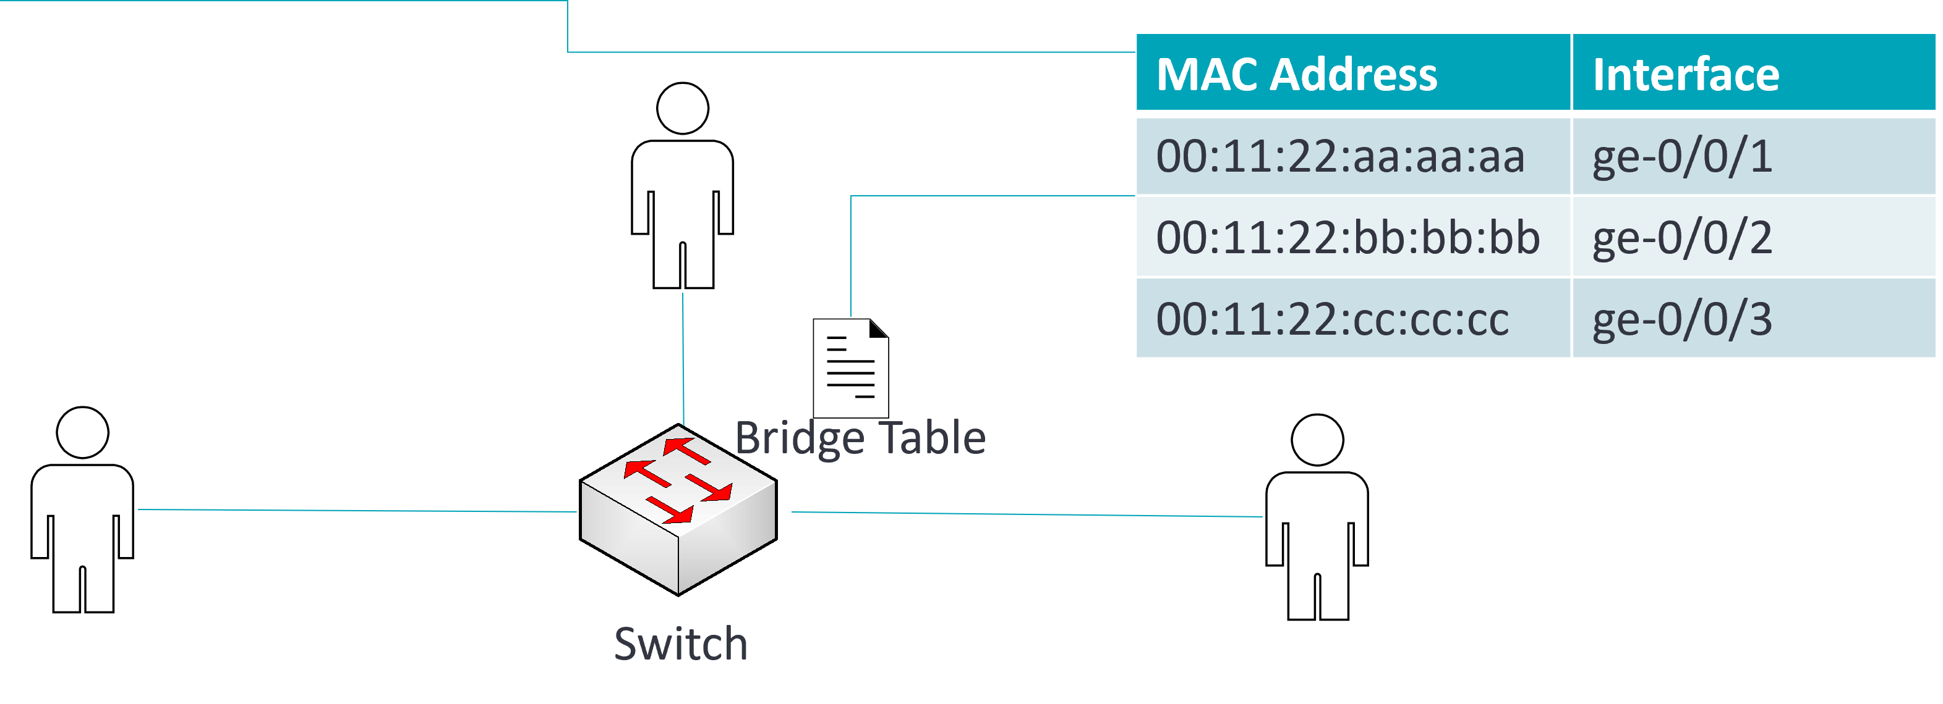
Bridging Mechanisms - Learning
Learning is the process that a switch uses to learn the MAC addresses of nodes on the network
Source addresses are associated with incoming interfaces in the Bridge Table
Preamble
Destination Address
Source Address
Type
Data
FCS

Slide 4
Bridging Mechanisms - Learning
MAC learning may be disabled on an interface or interface range on an EX series switch using the following command
user@Switch# set switch-options interface ge-0/0/0 no?
Possible completions:
no-mac-learning Disable dynamic MAC address learning

Slide 5
Bridging Mechanisms - Forwarding
The forwarding mechanism allows the switch to deliver traffic
The switch refers to the bridge table to find a forwarding entry for the destination MAC address of an incoming frame
Preamble
Destination Address
Source Address
Type
Data
FCS

Slide 6
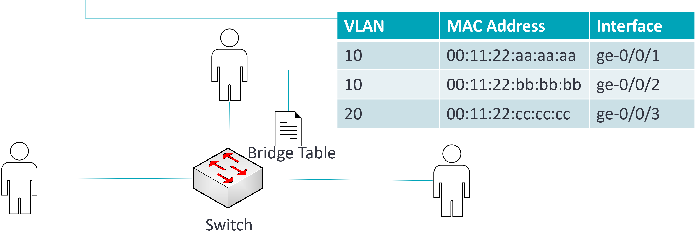
Bridging Mechanisms - Forwarding
Switches organize the bridge table by broadcast domain (VLAN)
Layer 2 traffic from one broadcast domain will not be forwarded to nodes on another broadcast domain.
Preamble
Destination Address
Source Address
Type
Data
FCS

